Slide 1
Home
SUREN
About Me
Projects
Hi,Iam suren pal and I am a front-end developer
Contact Me

Slide 2
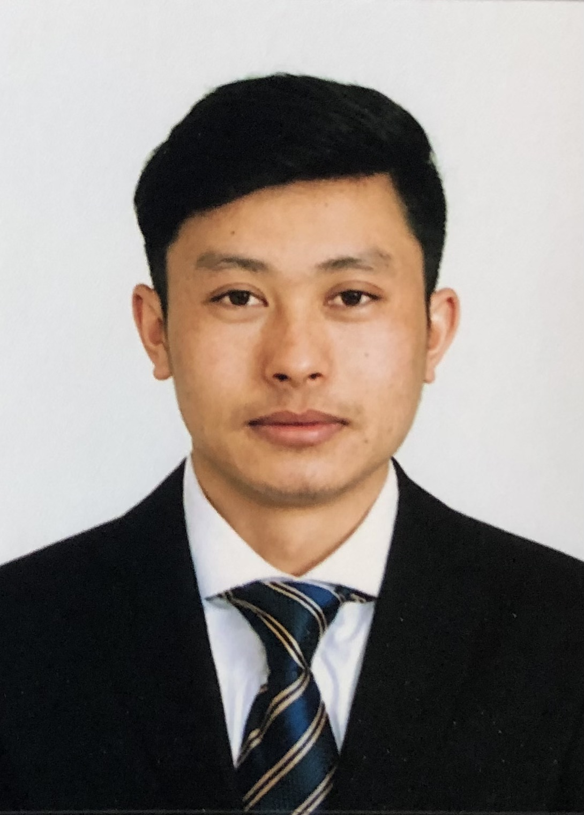
NAVIGATION BAR
About Me
Junior front-end developer
Paragraphs
Dip in IT
Address
Languages
A
B
C
D
Email ID
GitHub
Download Resume

Slide 3
NAVIGATION BAR
MY PROJECTS
Picture of the product
Picture of the product
APP NAME
Details
APP NAME
Details
Read More
Read More
FOOTER

